Slide 1
PCR
PUBLIC COMPLAINT RESOLVER
Enter Your Complaint
DEEPADHARSAN M
ASHWIN K
DHANUSH G
BALAJI S
1

Slide 2
Problem Statement
The existing complaint processing system (through digital application) by government officials for public in terms of registration and track of complaint process and receiving the acknowledgement for problem solved but there is possibilities of faux acknowledgement which is not known to the public .
A solution is required to develop to enable controlling of acknowledgement should be given to the public with feature of verification request
$62,000
Get a modern PowerPoint Presentation that is beautifully designed. I hope and I believe that this Template will your Time, Money and Reputation.
PCR
2
DELIVER PROGRESS REPORT

Slide 3
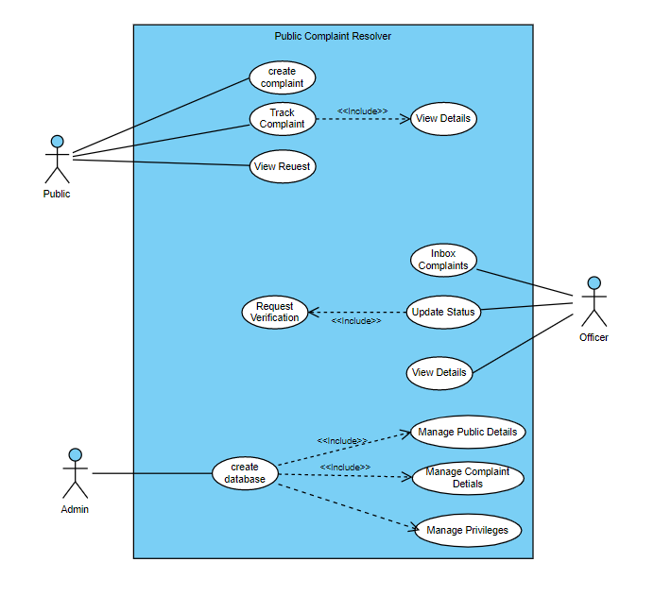
USECASE DIAGRAM
3

Slide 4
UML CLASS DIAGRAM
Class name : officer
name : int govt_id : int dob : date aadhar_no : long zone : string role : string
set_info() get_info() Change_info() request_verify()
Class name : complaint
complaint_id : int name : String pub_user : int details : string zone : string type : String
new_complaint() track_complaint() get_details() delete_complaint() search_complaint()
Class name : login
name : string password : int role : string
Verify_data() create_pub prof() create_off_prof()
Class name : people
name : int random_Id : int dob : date aadhar_no : long address : string pincode : int
set_info() get_info() Change_info() Verify_complaint() redirect()
4

Slide 5
STATE CHART DIAGRAM
Start
Get
complaint info
submit
End
Create complaint
Complaint status
complete
Complaint confirmation
No
Yes
Already
exist?
Yes
Is Privileges matches?
Send to zone office
Send to Server
Yes
No
No
No
Taking actions
for the given complaint
complete
Is Verified?
Yes
Process complaint
Undergone process
Completion Process
5

Slide 6
ACTIVITY DIAGRAM
people | complaint | Admin | Officer
Start
Create complaint
Save complaint
Verify / new complaint
Processing complaint
Successful
notification
Successful
notification
Display notification
Update complaint status (Just Applied)
Update complaint
Status(on Process)
no
complete
Check complaint status
Display status
yes
Confirm completion
Forward to public
Request verify
Update Complaint
Status(completed)
6
Stop

Slide 7
SEQUENCE DIAGRAM
Firebase Authentication
System
Officer
Public
login
Success
Register Complaint
Verify &
Send
Verify &
Send
Processing Complaint
Verifying Completion
Tracking Complaint
Exit
7

Slide 8
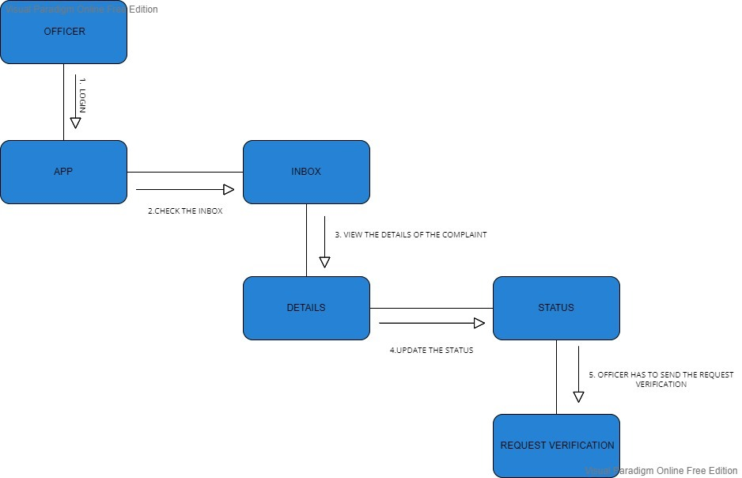
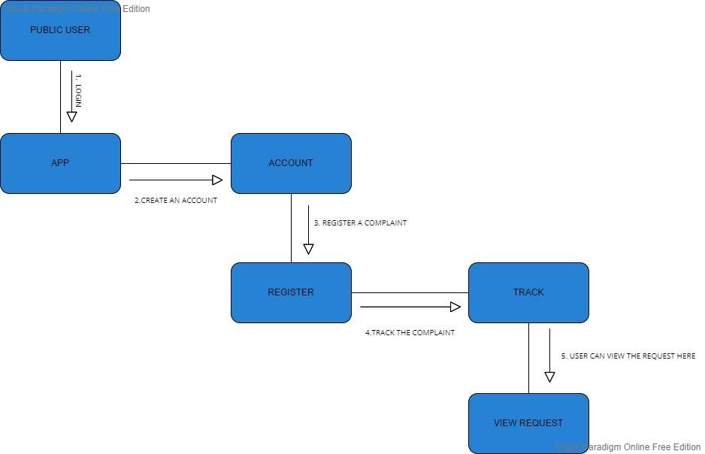
COLLABORATION DIAGRAM
8

Slide 9
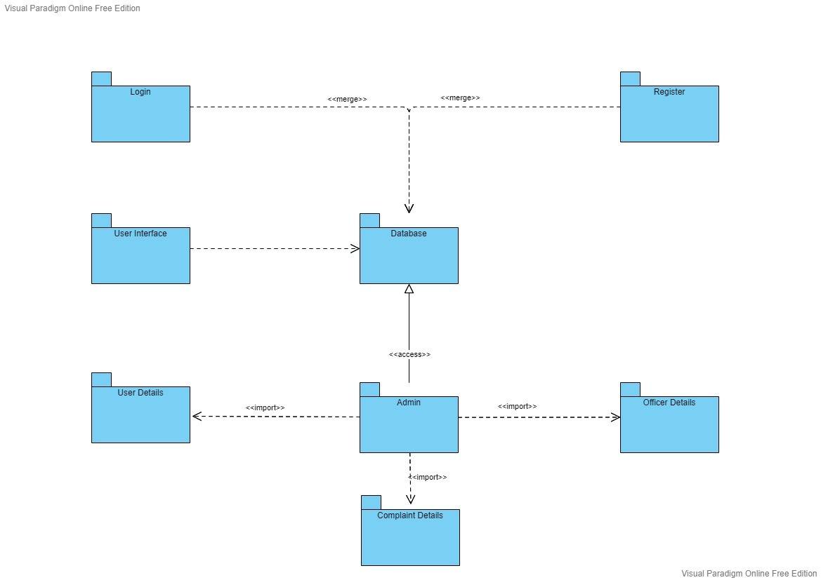
PACKAGE DIAGRAM
9

Slide 10
MODULES
Option View
Officer
Public
Inbox Complaint
Signup
Login
Update Status
Create complaint
Track Complaint
View Details
Raised Complaint
Request Verification Sent
View Requests
10

Slide 11
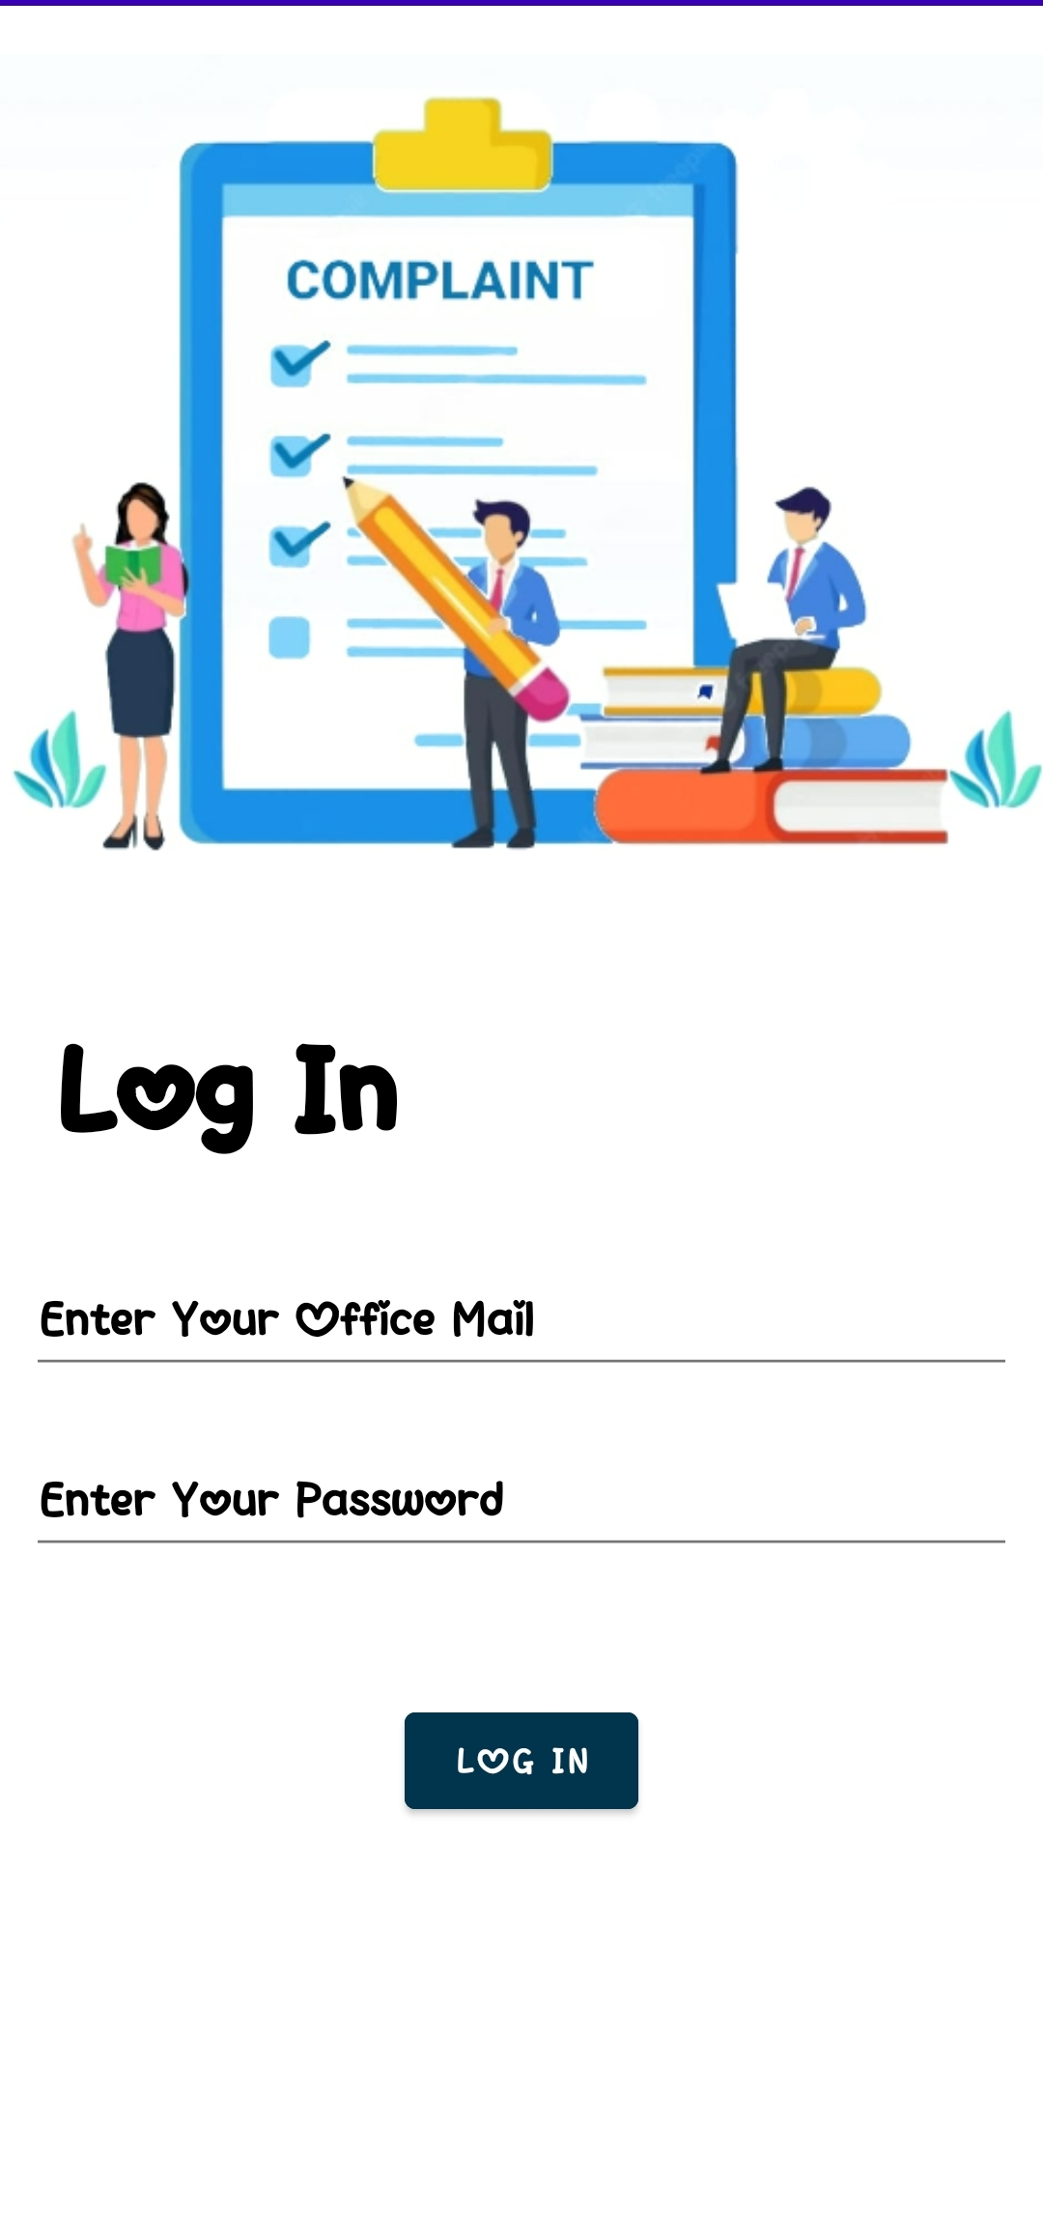
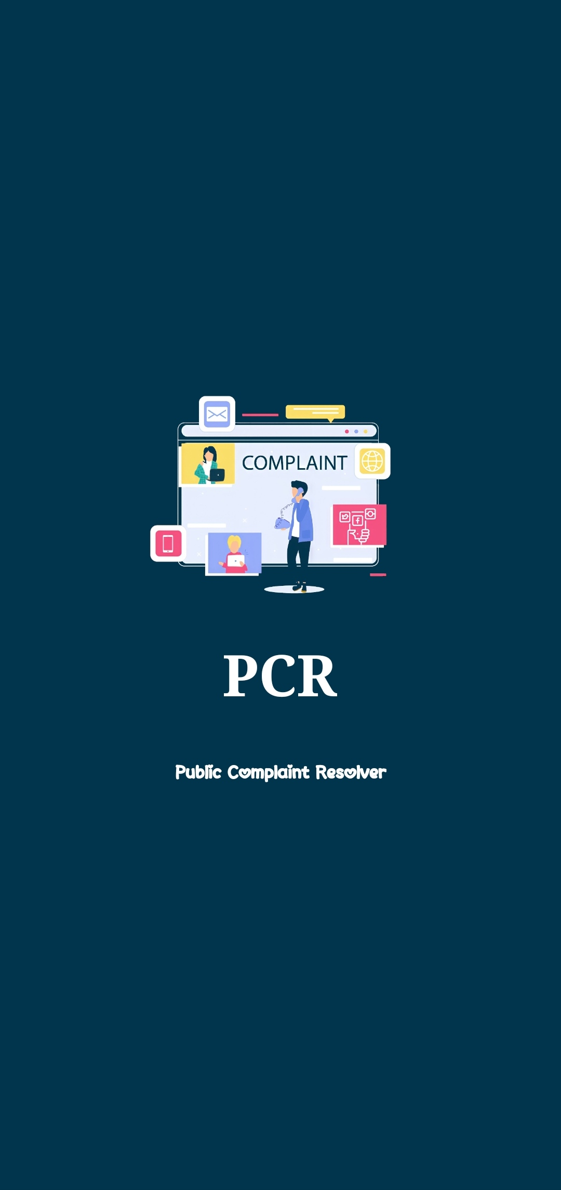
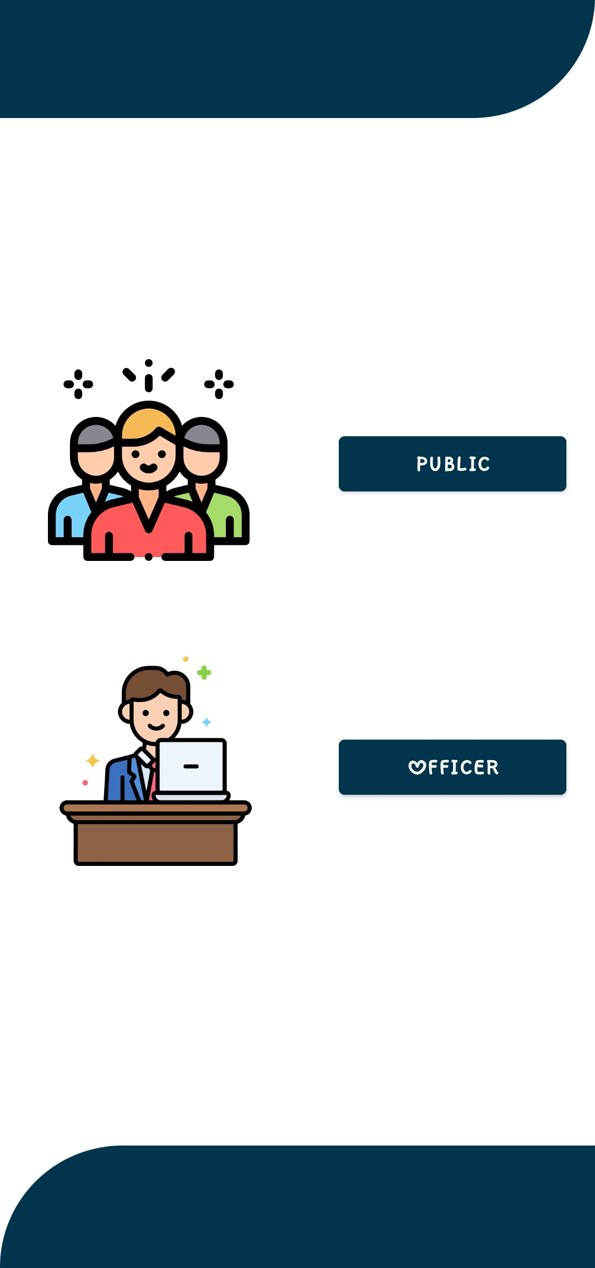
OPTION VIEW (OFFICER)
<<officer>>
11

Slide 12
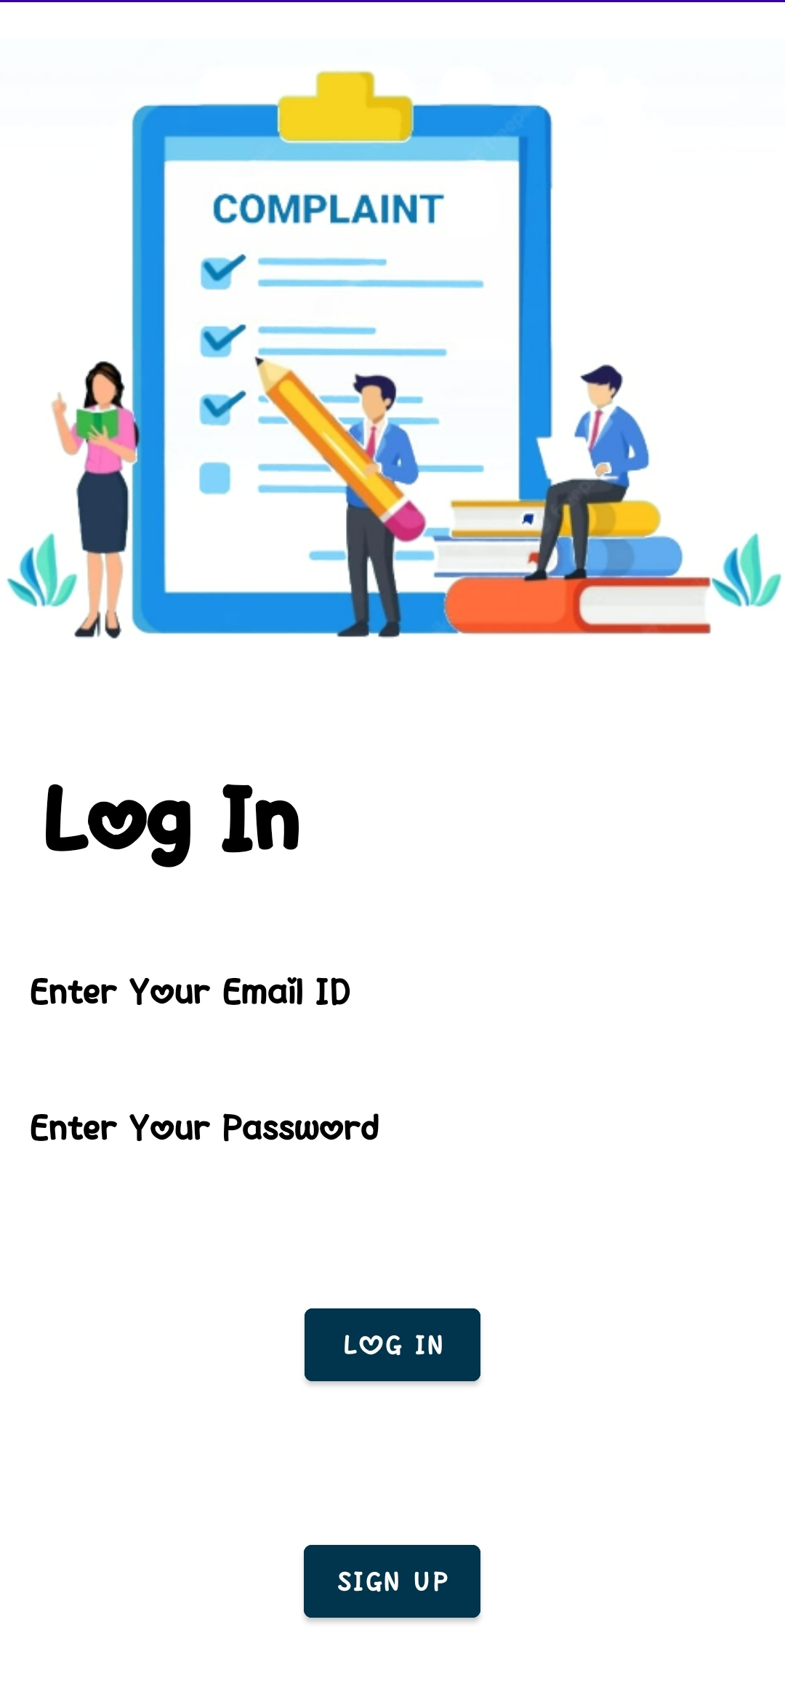
OPTION VIEW (PUBLIC)
<<public>>
12

Slide 13
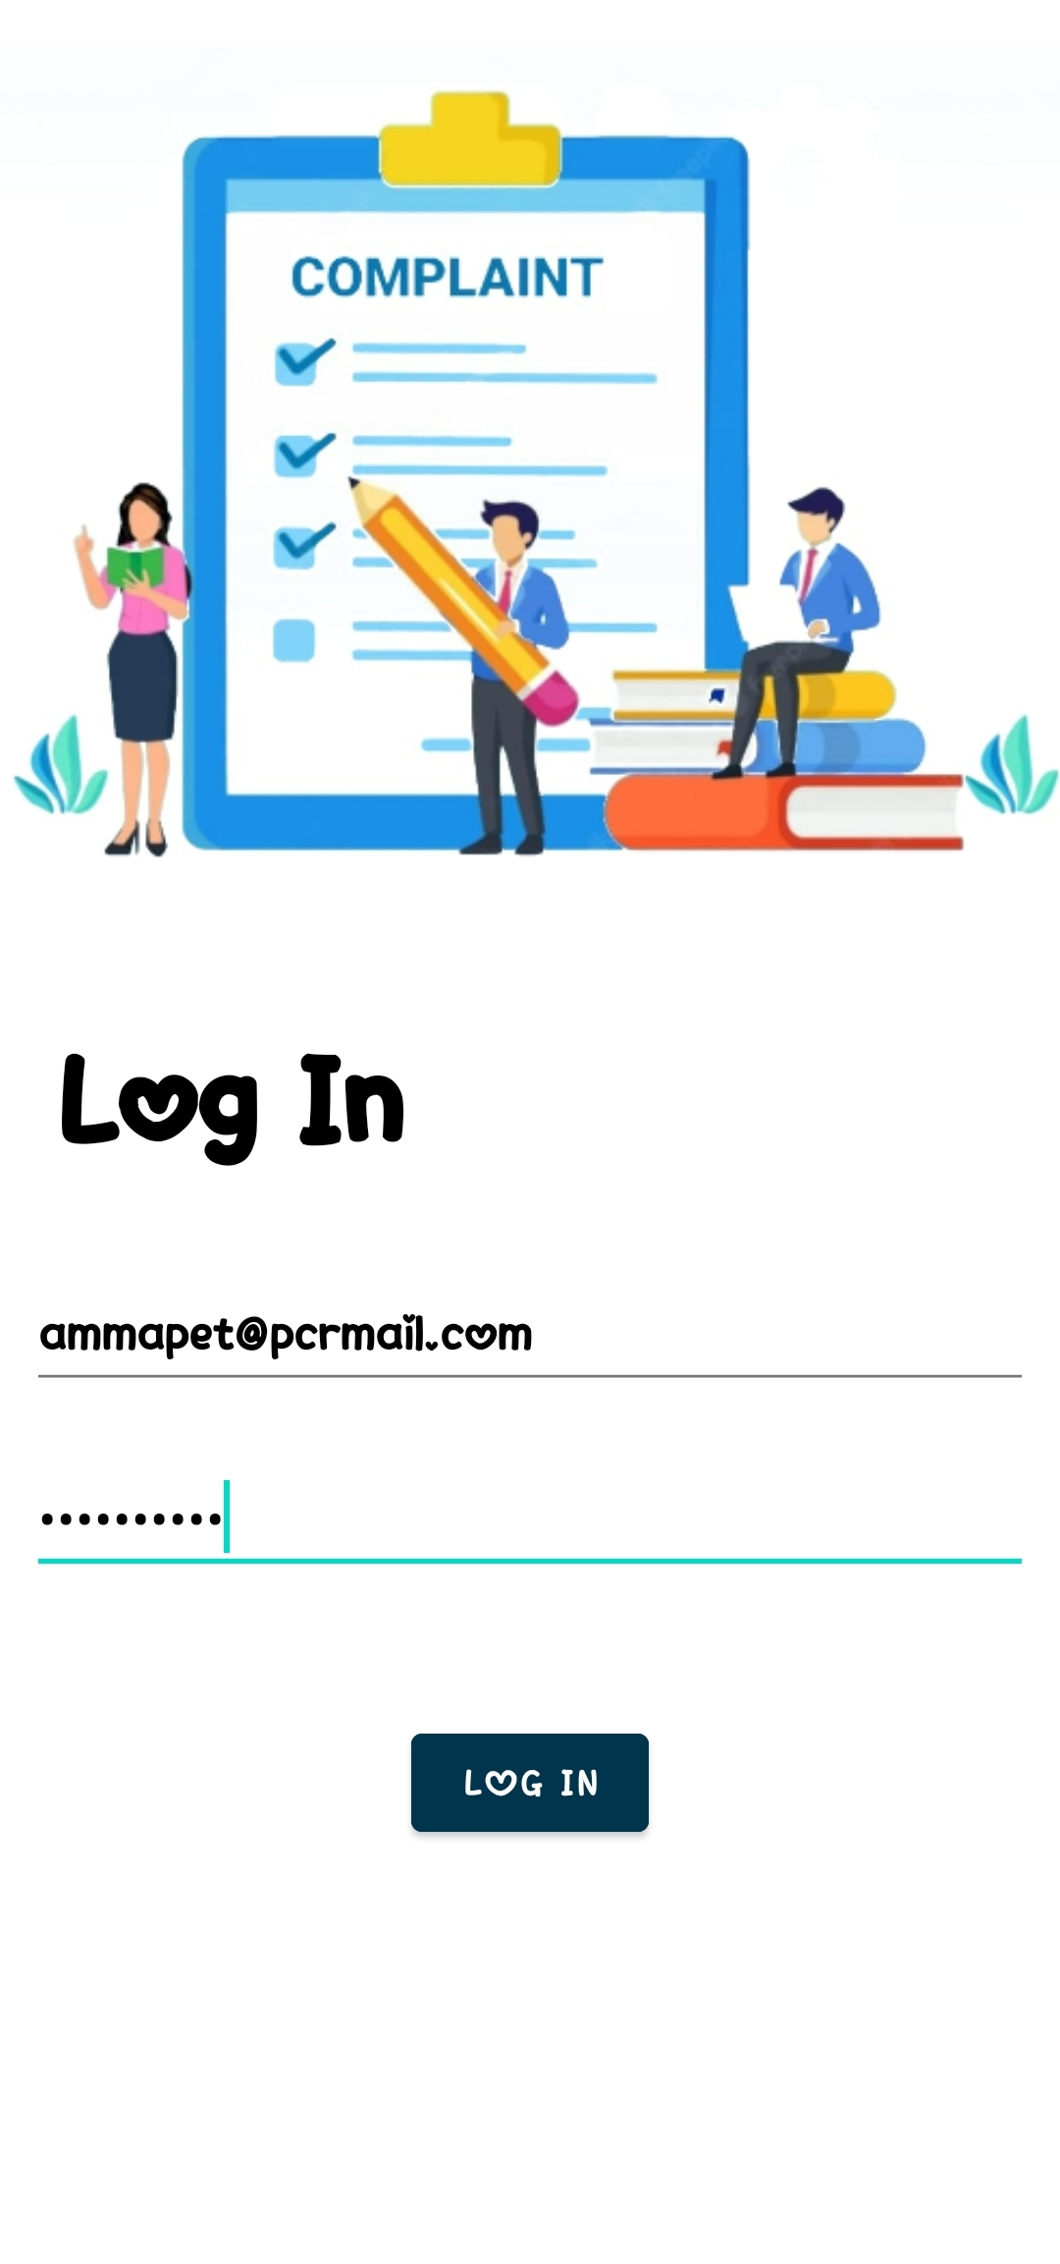
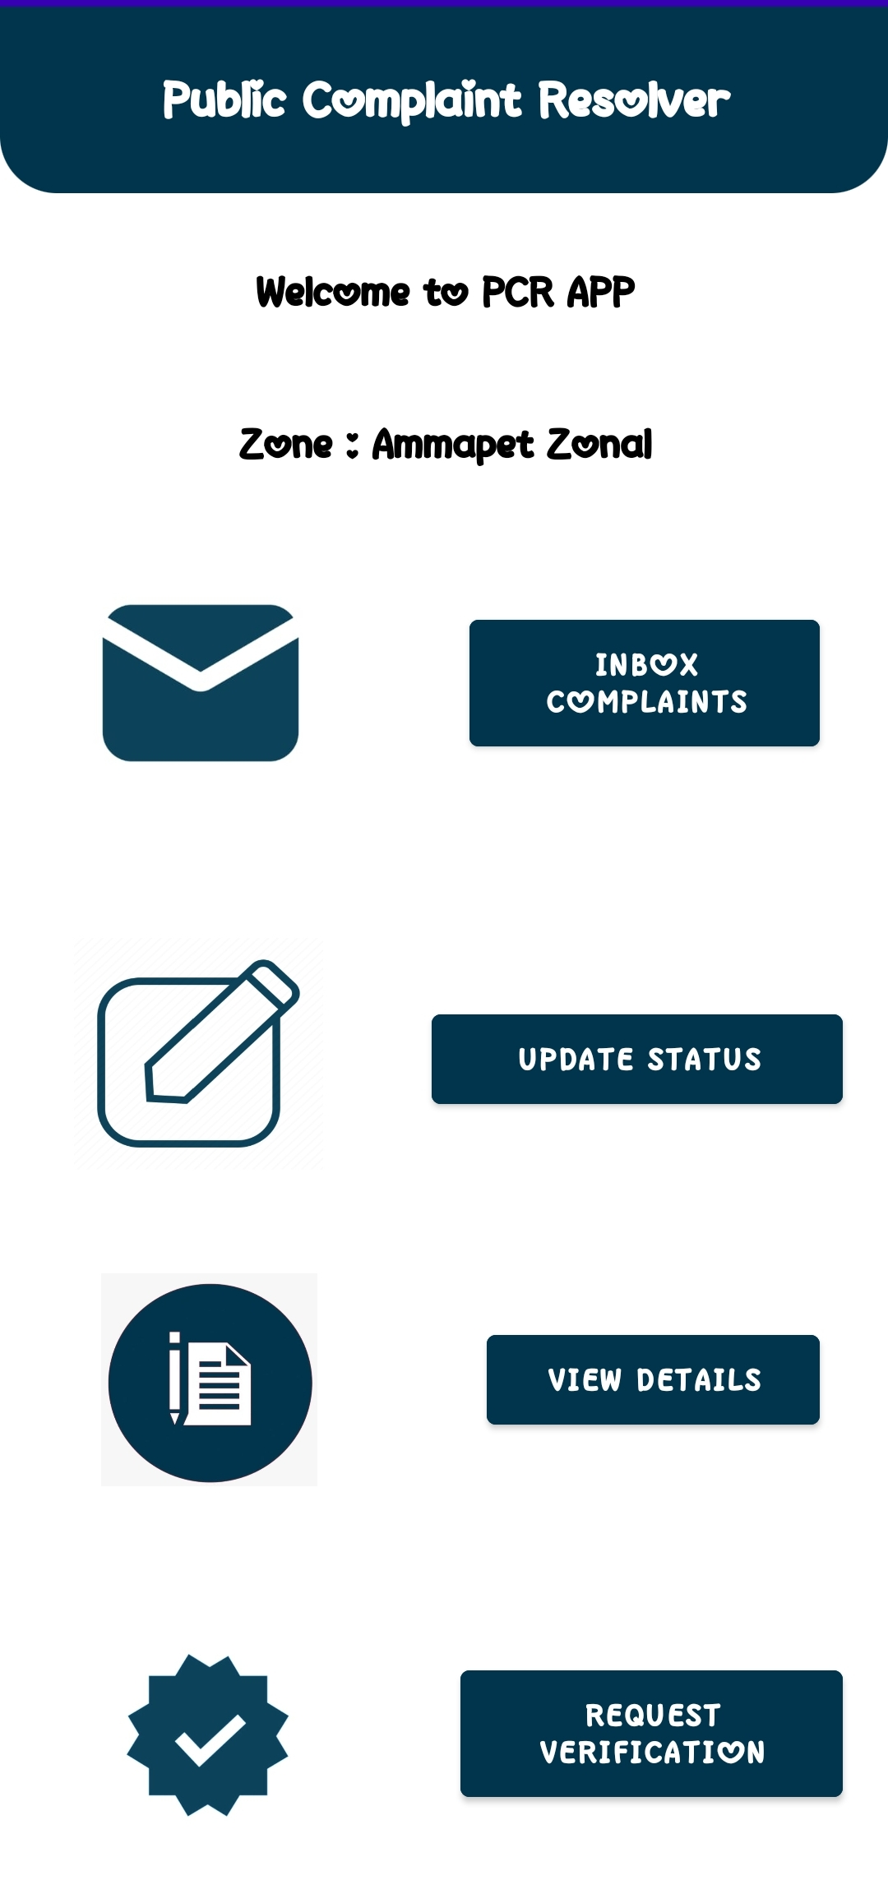
OFFICER (LOG IN)
<<login>>
<<officer>>
13

Slide 14
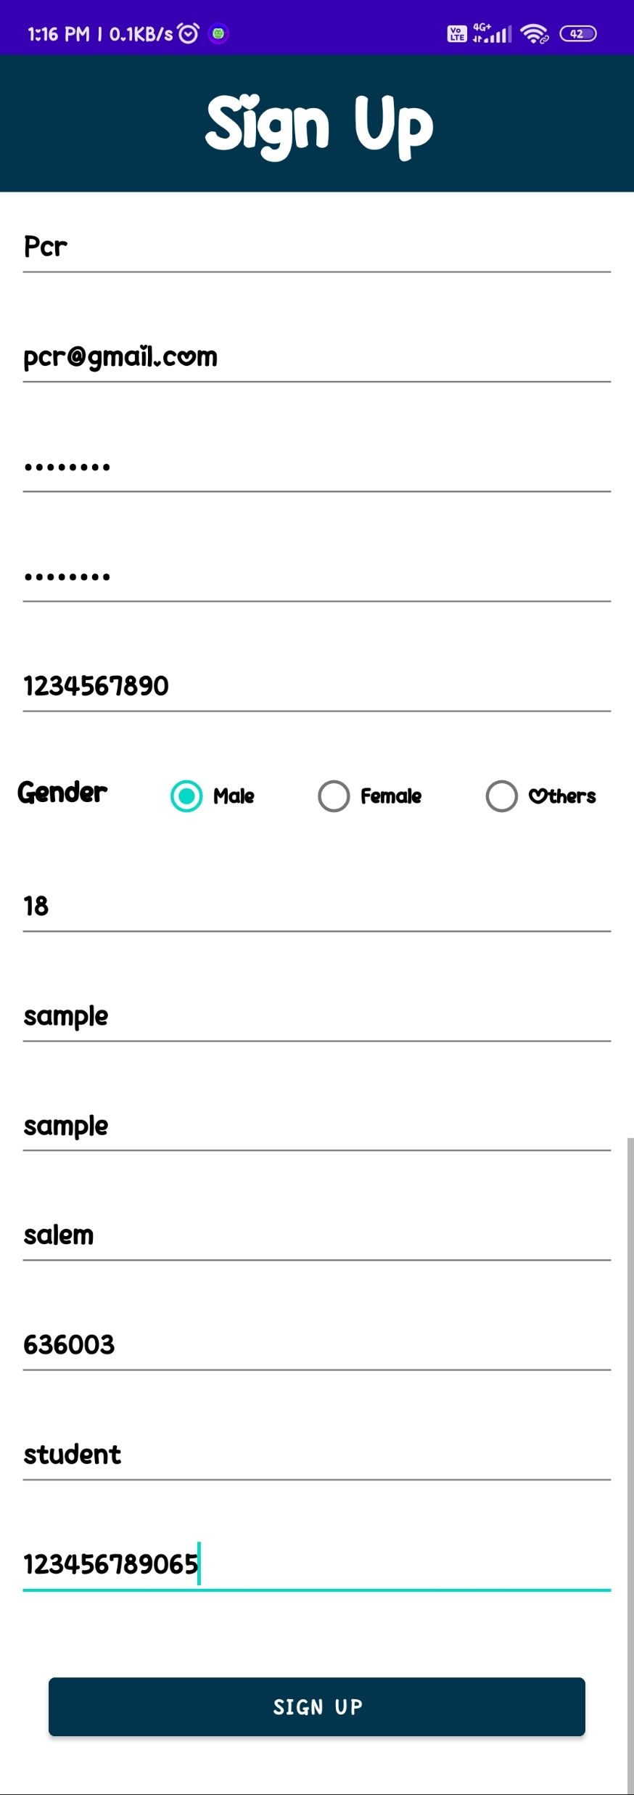
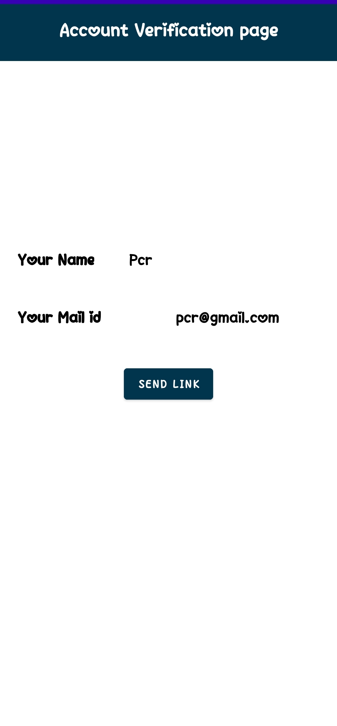
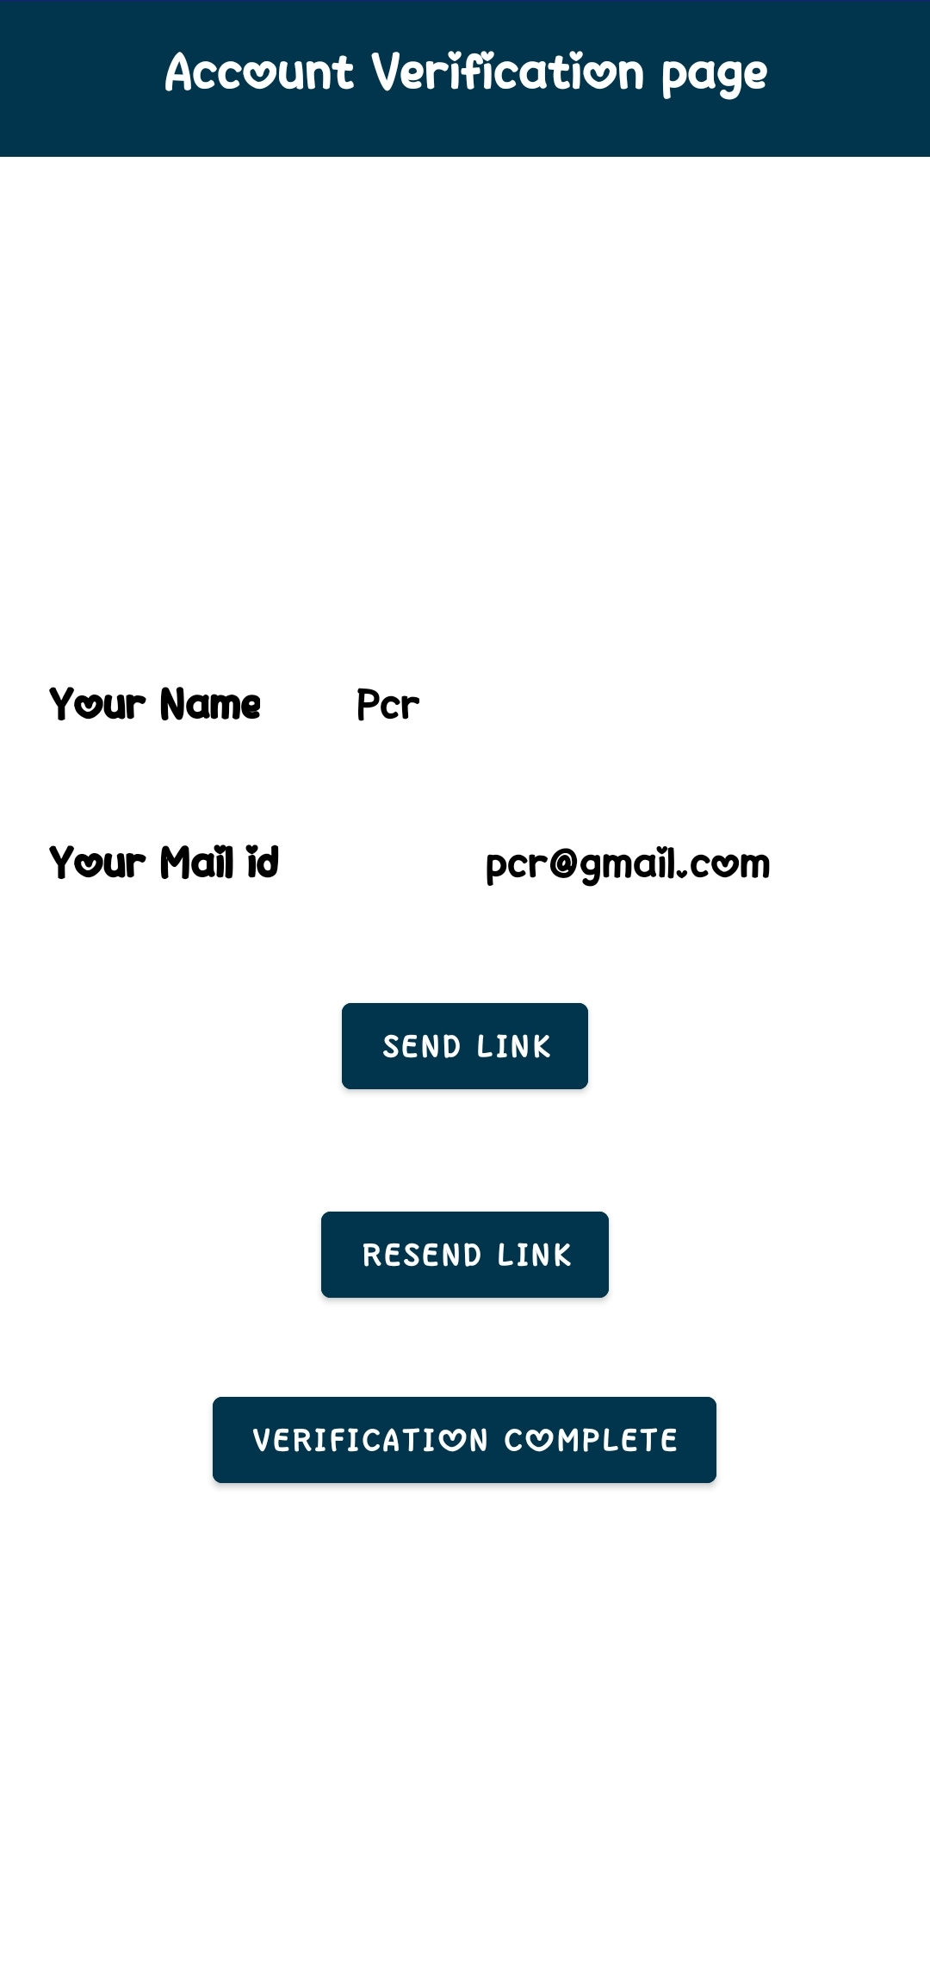
PUBLIC (SIGN UP)
<<signup>>
<<send-link>>
<<signup>>
14

Slide 15
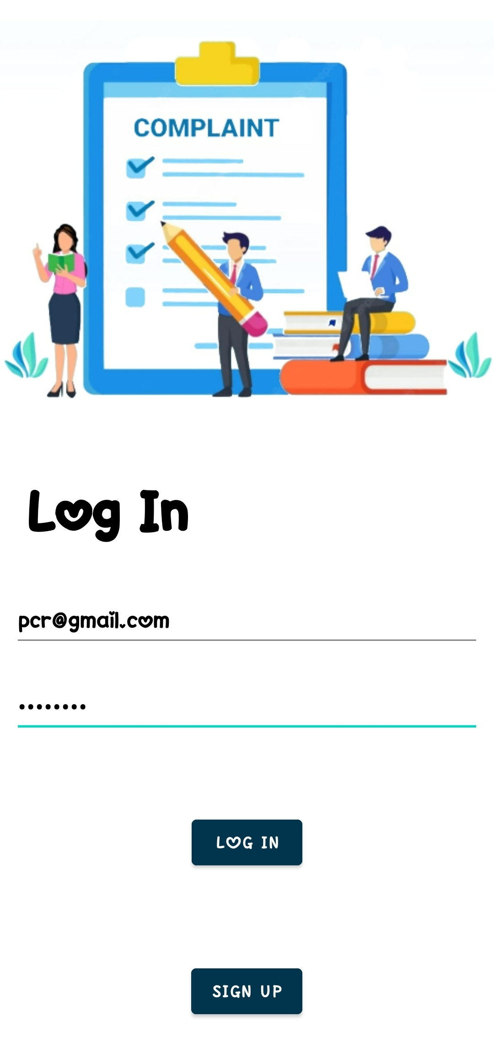
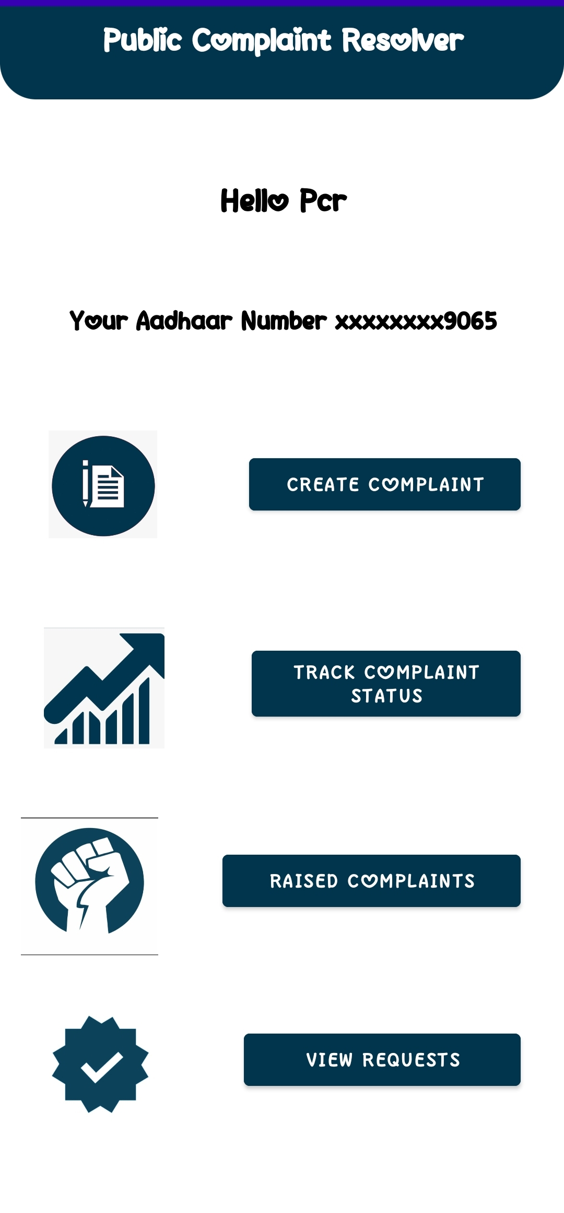
PUBLIC (LOG IN)
<<public>>
<<login>>
15

Slide 16
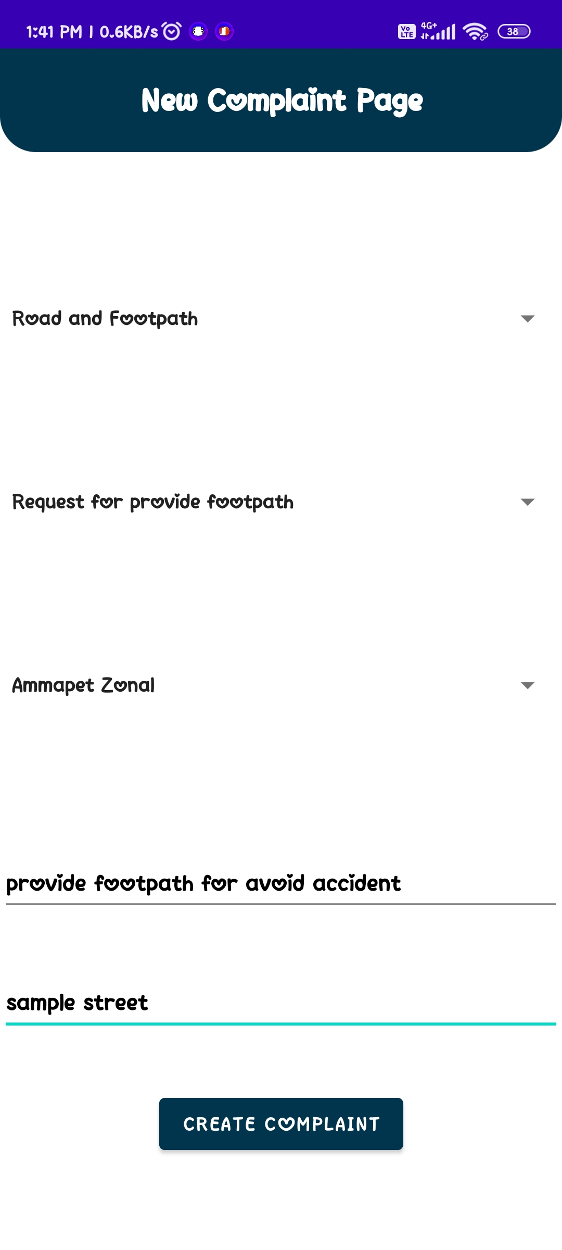
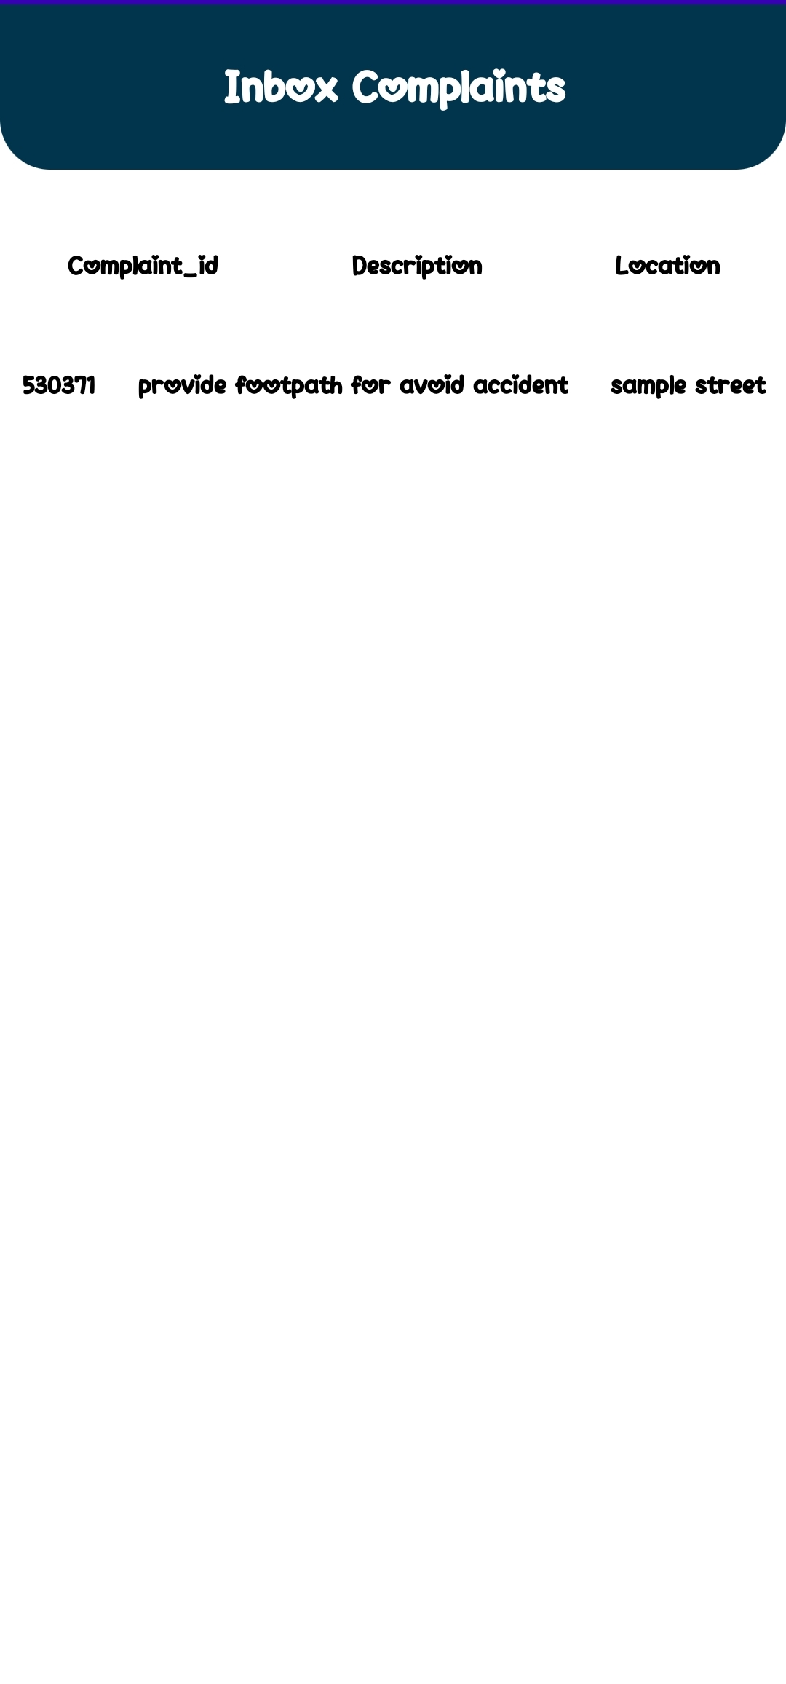
COMPLAINT (CREATE & INBOX)
<<create>>
<<inbox>>
OFFICER
PUBLIC
16

Slide 17
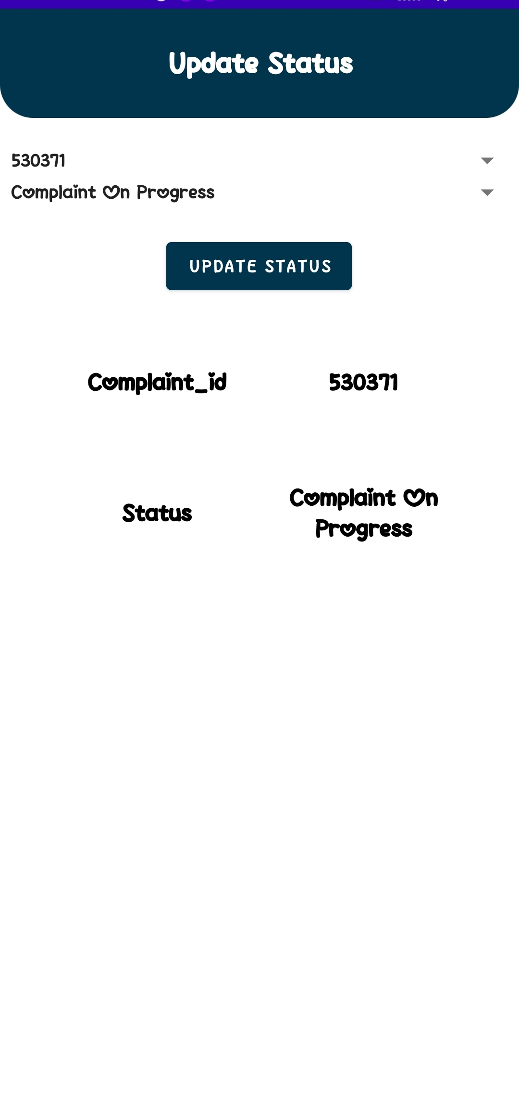
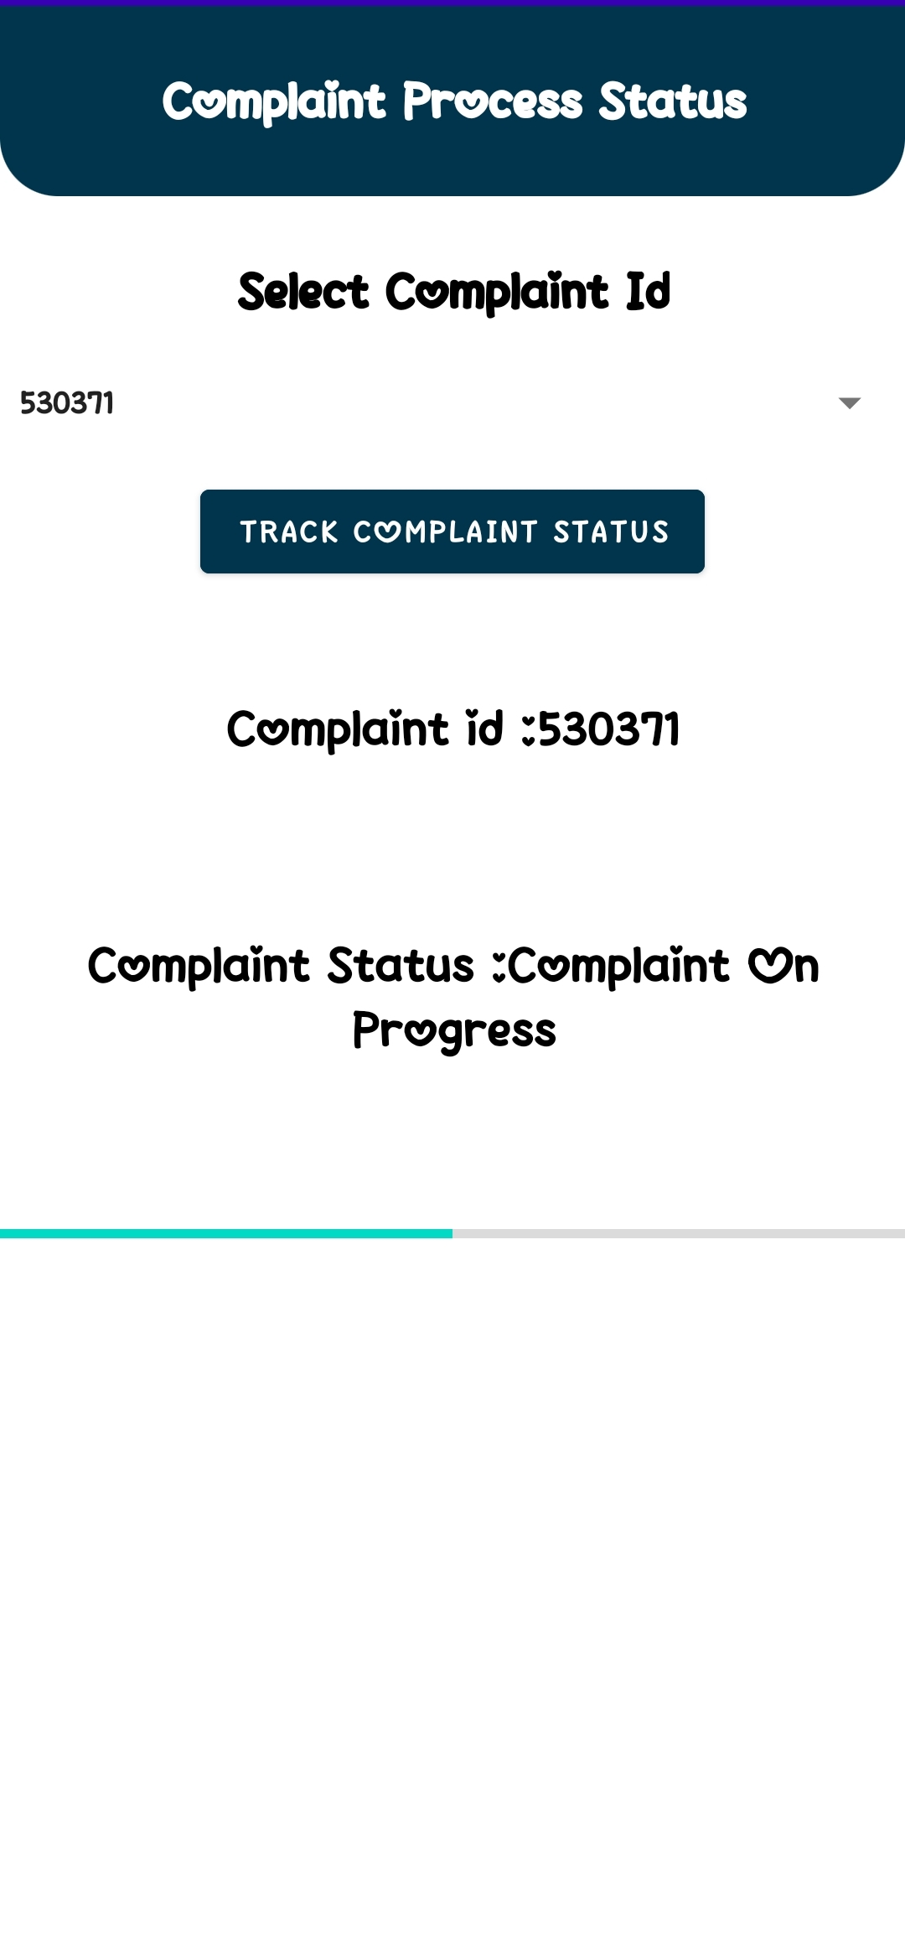
COMPLAINT (UPDATE & TRACK)
<<update>>
<<track>>
OFFICER
PUBLIC
17

Slide 18
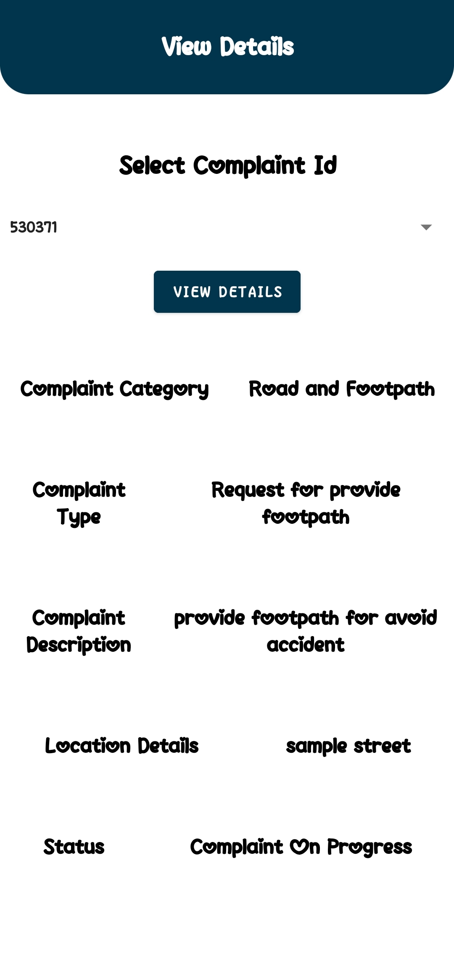
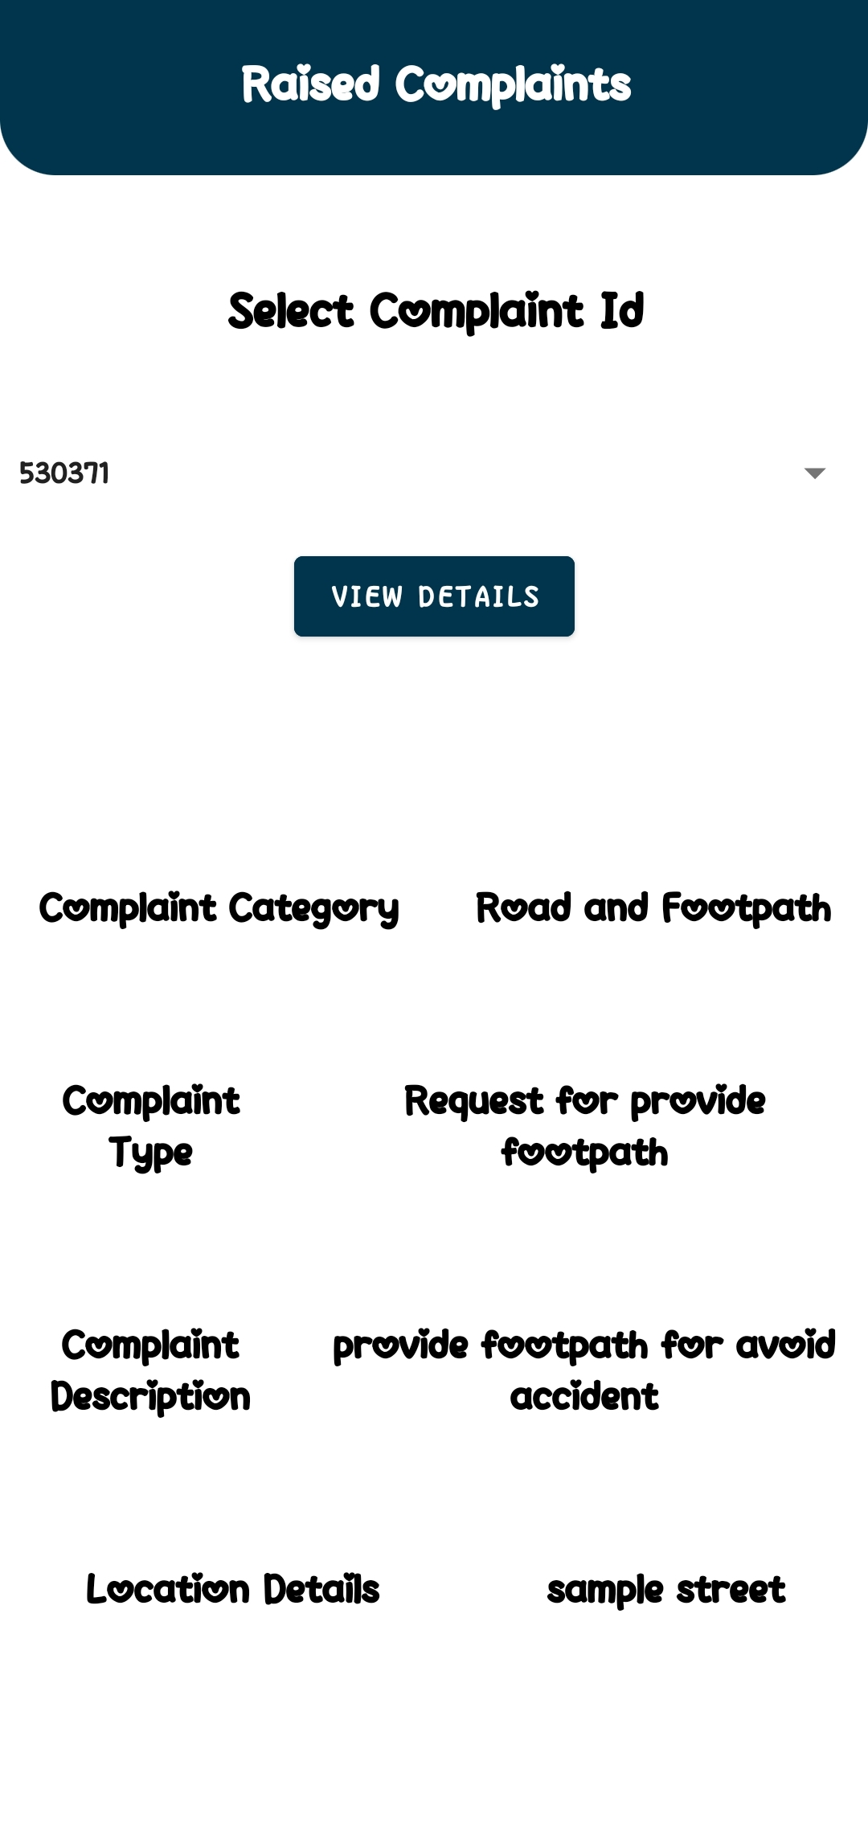
COMPLAINT (VIEW & RAISED)
<<view>>
<<raised>>
OFFICER
PUBLIC
18

Slide 19
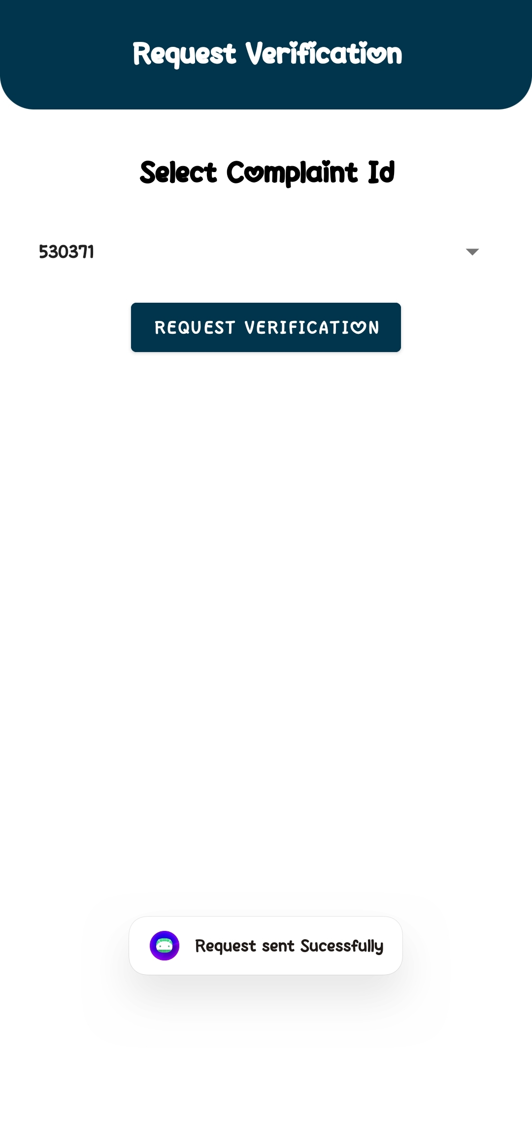
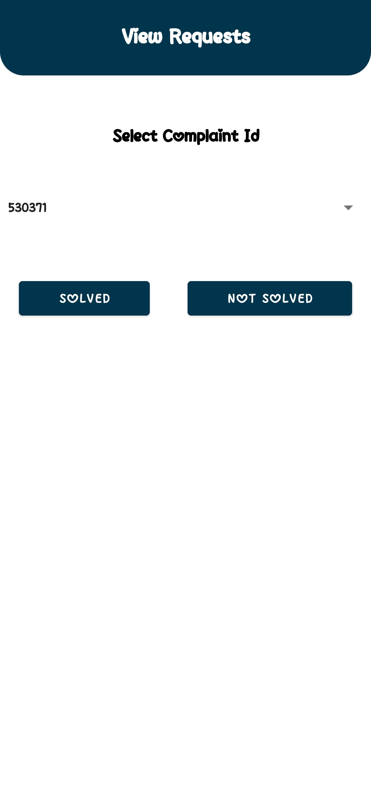
COMPLAINT (REQUEST)
<<request>>
<<view-requests>>
OFFICER
PUBLIC
19

Slide 20
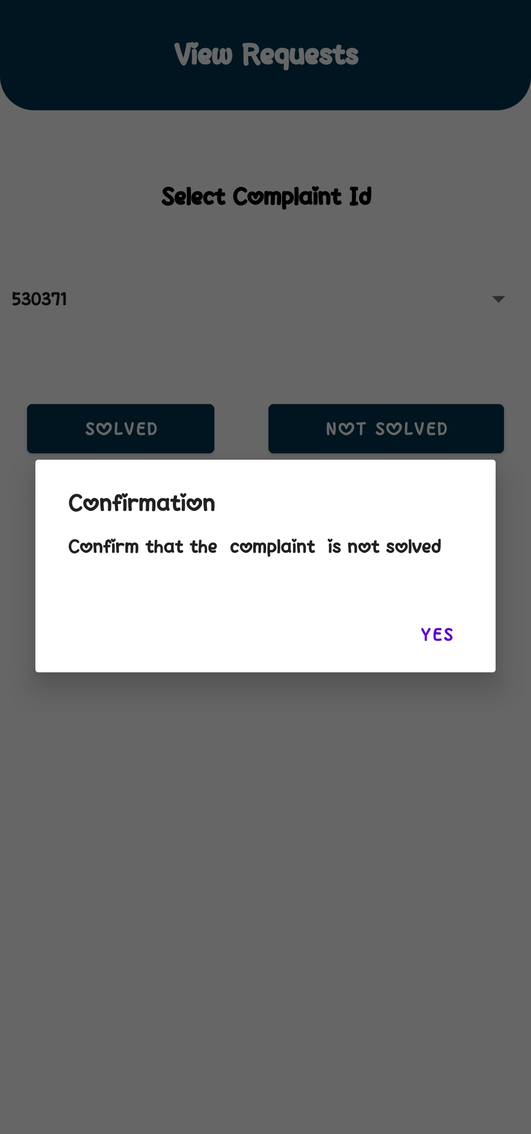
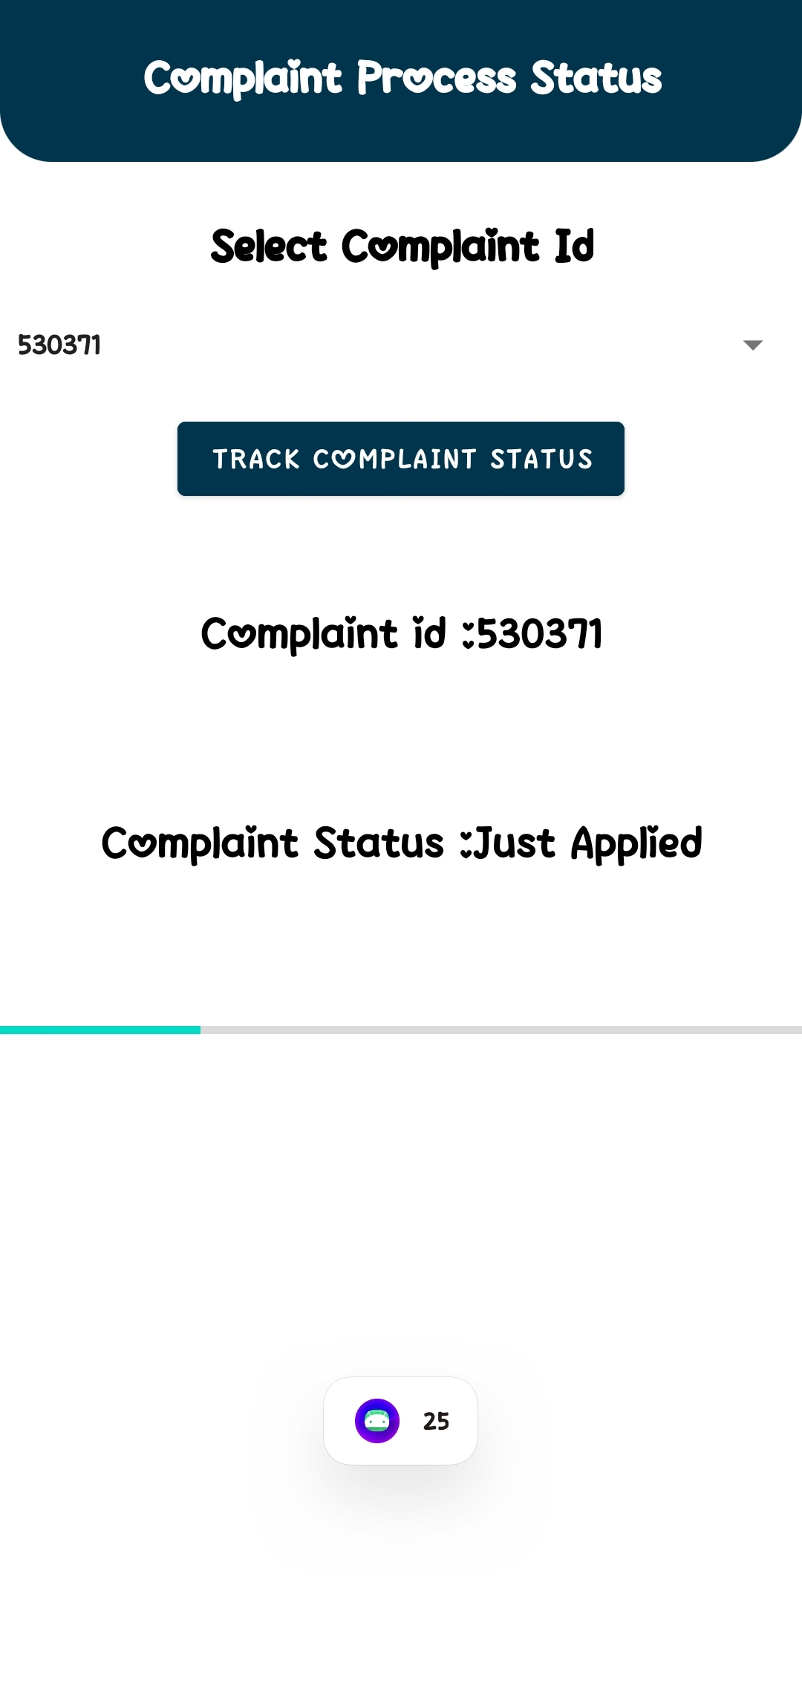
COMPLAINT (NOT SOLVED)
<<view-requests>>
<<status>>
<<not-solved>>
20

Slide 21
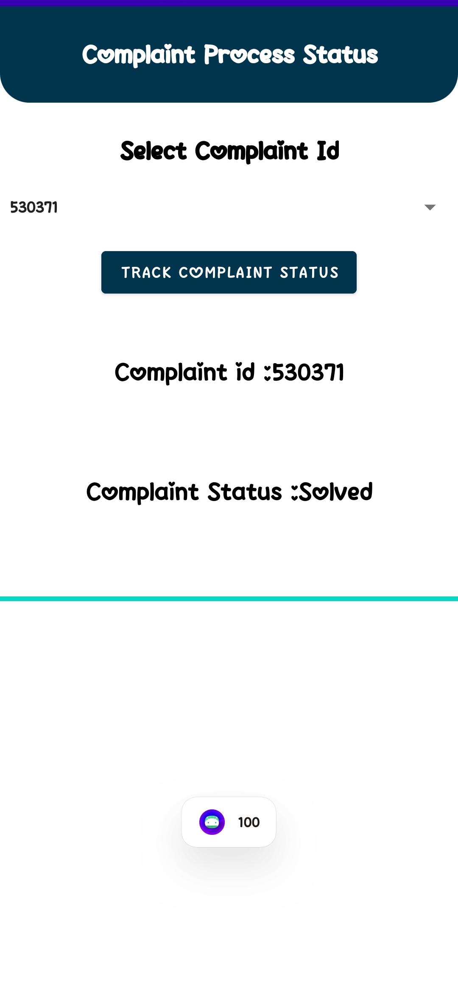

COMPLAINT (SOLVED)
<<view-requests>>
<<solved>>
<<status>>
21

Slide 22
SCREEN RECORD LINK
https://drive.google.com/file/d/1TrEkn81sfCpoRSikUvm9bRf7rUtnMy8Z/view?usp=sharing
22

Slide 23
THANK YOU
for giving this opportunity
23

